Slide 1
Biopharmaceutics and pharmacokinetics IV Bolus Blood Data
Suez canal university.
Faculty of pharmacy .
Pharmaceutics department .
Passant M. Al-Maghrabi

Slide 2
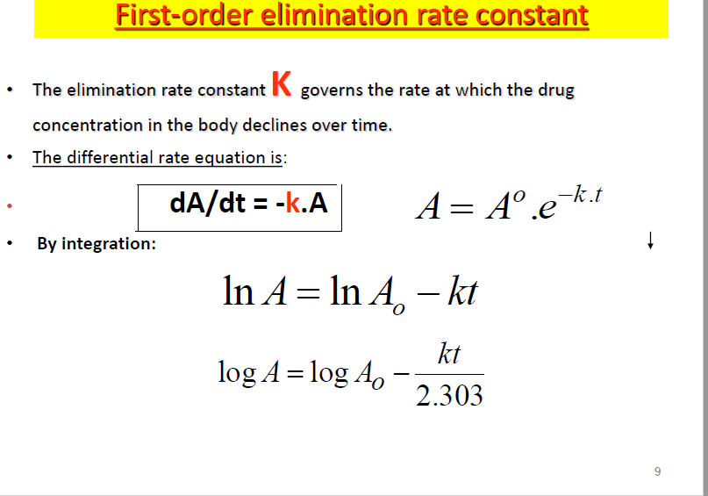

Slide 3
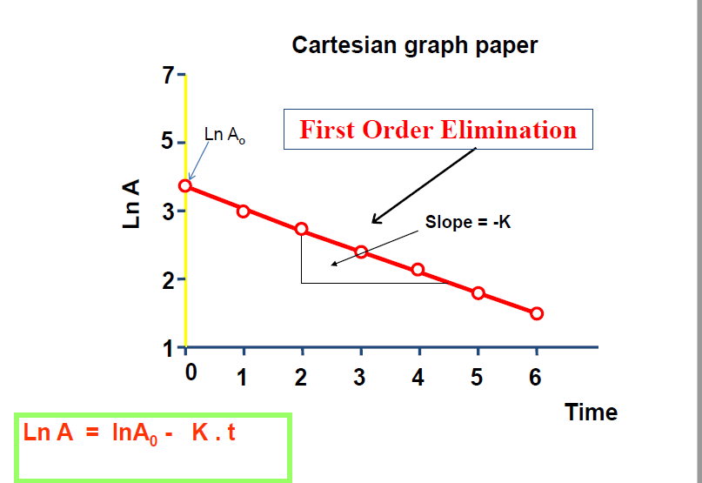

Slide 4
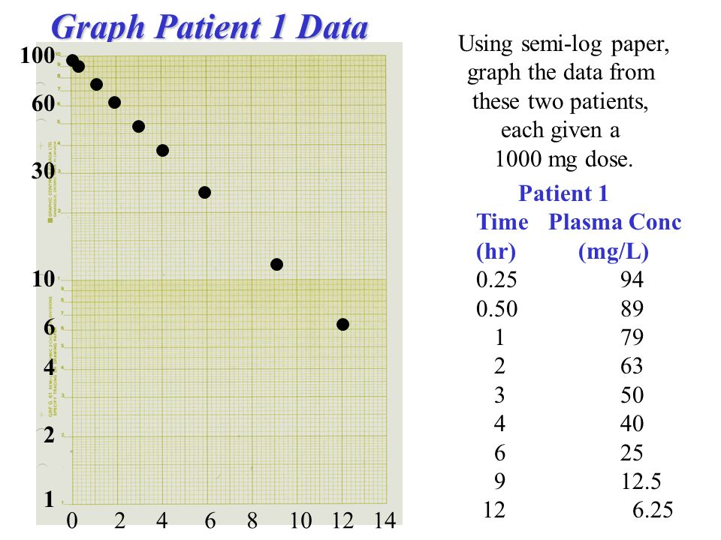

Slide 5
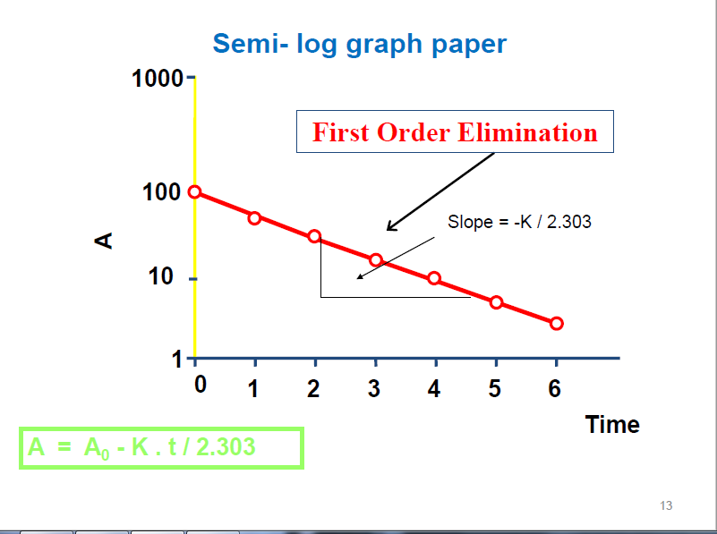

Slide 6
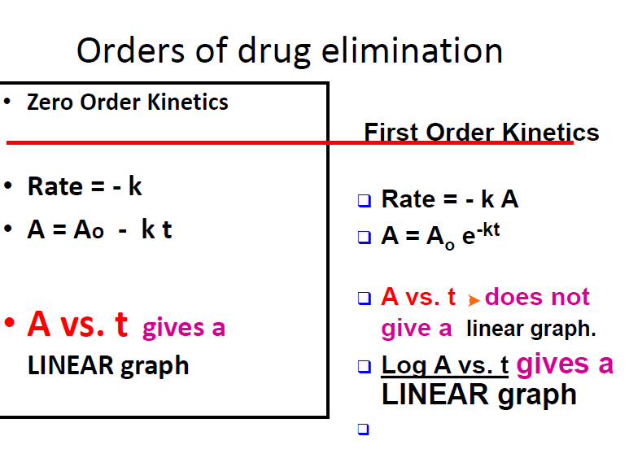

Slide 7
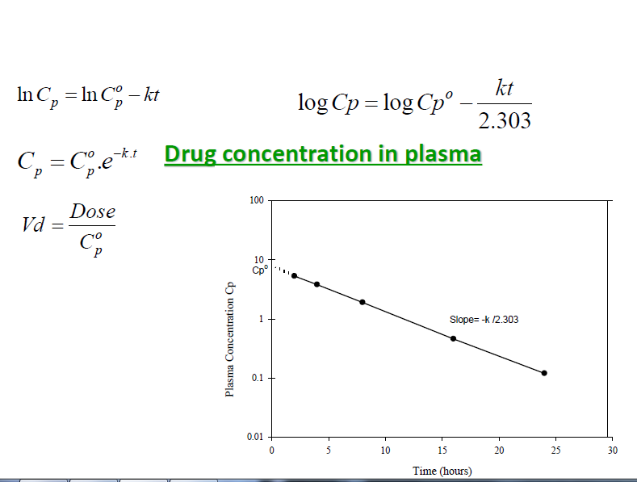
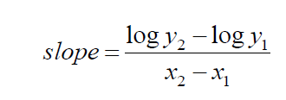

Slide 8
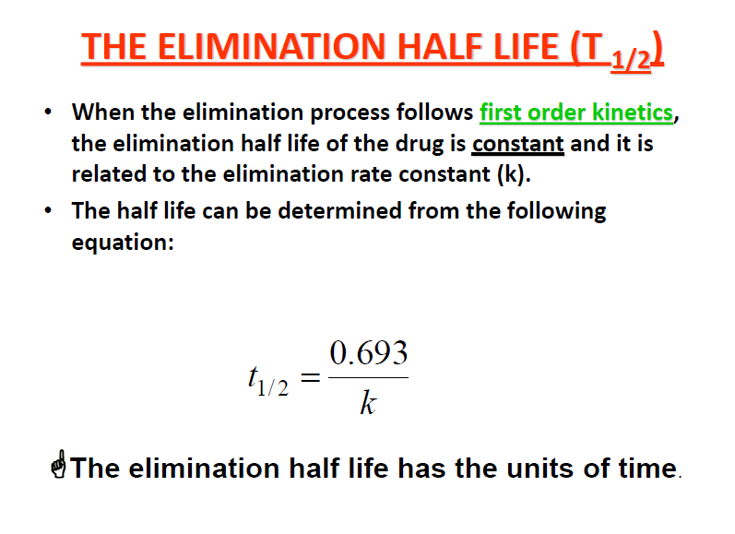

Slide 9
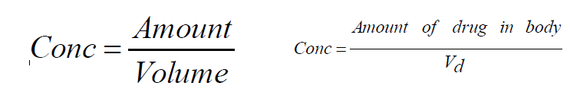

Apparent volume of distribution

Slide 10
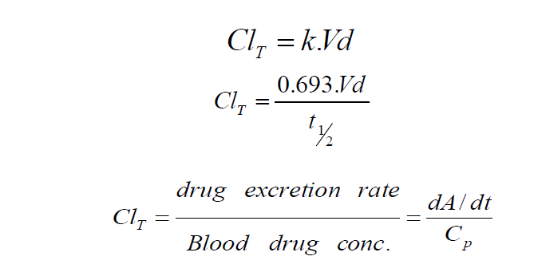
Total body clearance :

Slide 11
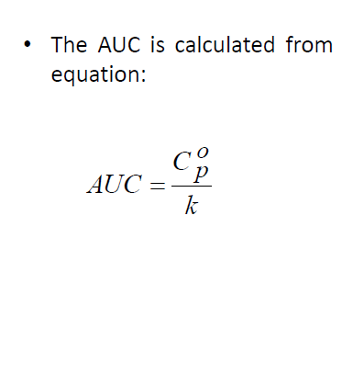
Calculation of AUC

Slide 12
Problem 1:
A 50 Kg woman was given a single IV dose of an antibacterial drug at a dose level of 6 mg/kg . Blood samples were taken at various time intervals . The concentration of the drug (Cp) was determined in the plasma fraction of each blood sample and the following data were obtained .

Slide 13
Cp (Ug /ml ) | Time (hr)
8.21 | 0.25
7.87 | 0.5
7.23 | 1
5.15 | 2
3.09 | 6
1.11 | 12
0.4 | 18

Slide 14
A- what are the values for Vd ,K, t ½ ?
B- How long would it take for 99.9 % of this drug to be eliminated ?
D- If the dose of the antibiotic were doubled exactly . What would be the increase in duration of activity ?

